Slide 1

Real-Time BLDC Motor Condition Monitoring, Fault Detection and Predictive Maintenance Using ESP32
PROJECT PRESENTATION · GROUP 17
MUKUNDAN · CB.EN.U4EEE24124
SADA SIVA SURYA SRINIVAS · CB.EN.U4EEE24128
Department of EEE | Amrita Vishwa Vidyapeetham
Notes:
Introduce Group 17, the two team members and the project title.

Slide 2






Current Problem
≈ 70%
Unexpected motor failure
High maintenance cost
Production downtime
of industrial electrical energy is consumed by motors
Energy wastage
Manual inspection
No remote monitoring
Conventional BLDC drives only control speed and torque.
Modern industries need intelligent drives with health monitoring and predictive maintenance.
Notes:
Industrial motors use most of the electrical energy, and unexpected failures cause downtime. Conventional BLDC drives only control speed and torque.

Slide 3
Literature Review
1
Raja et al. (2022)
Cost-efficient real-time condition monitoring and fault diagnostics system for BLDC motor using IoT and machine learning
BLDC · IoT + ML
2
IoT based condition monitoring (2022)
IoT based condition monitoring and control of induction motor using Raspberry Pi
Induction · Raspberry Pi
3
do Nascimento, da Silva & Pereira (2024)
Development of a data acquisition and monitoring system for electric motors using the Internet of Things
ESP32 · temp, current, vibration
4
Arman Sabri & Aziz (2025)
Motor vibration and temperature detector by using IoT
ESP32 · DS18B20 · Blynk
5
Wan Mohd Supian et al. (2022)
Electrical machine breakdown monitoring system using IoT
ESP32 · ACS712 · Blynk
Most reviewed work targets induction or AC motors and monitors only a few parameters.
Notes:
Five related studies. Four monitor induction or AC motors with ESP32 or Raspberry Pi platforms; only one targets BLDC motors.

Slide 4


Research Gap
Existing systems
Research gap
No low-cost integrated BLDC drive combining:
BLDC drives only perform speed control
Power electronics
Monitoring tracks temperature, current or vibration alone
Drive control
Energy monitoring
Expensive
IoT
Separate hardware required
Predictive maintenance
Notes:
Existing drives only control speed and existing monitors cover single parameters; no low-cost integrated BLDC drive combines the five capabilities.

Slide 5





Novelty
WHAT IS NEW
The system turns a conventional BLDC drive into an intelligent, self-monitoring drive on a single low-cost platform. Unlike systems that only control the motor or watch isolated parameters, it continuously evaluates motor health and gives early maintenance recommendations while keeping operation efficient.
Power electronics
Motor protection
Multi-parameter monitoring
IoT remote supervision
Energy analytics
Predictive maintenance
Notes:
One low-cost platform that combines drive, monitoring, IoT and predictive maintenance.

Slide 6
Objectives
1
2
3
4
Design and simulate a BLDC motor drive with a three-phase power converter
Protect the motor by disabling the drive on critical faults
Monitor voltage, current, power and energy in real time
Monitor motor vibration and temperature
5
6
7
8
Detect overload, overheating and mechanical abnormalities by multi-parameter analysis
Enable IoT remote monitoring with ESP32 and a cloud dashboard
Provide predictive maintenance with early fault warnings
Validate through MATLAB/Simulink simulation and hardware implementation
Notes:
Eight objectives covering the drive, monitoring, fault detection, IoT, predictive maintenance and validation.

Slide 7
Methodology
1
Literature Survey
2
BLDC Drive Modeling
3
Drive Control
BLDC drives, fault detection, IoT monitoring, predictive maintenance
Simulink: DC source, three-phase converter, commutation, BLDC motor
Fixed commutation, no speed loop
4
Parameter Monitoring
5
Fault Simulation
6
Fault Detection
Voltage, current, power, energy, temperature, vibration
Overload, over-temperature and mechanical vibration faults
Classify condition: Healthy, Warning or Fault
7
Predictive Maintenance
8
IoT Integration
9
Validation
Estimate motor health from sensor data and raise maintenance alerts
ESP32 sends live data to a cloud dashboard
Compare MATLAB simulation with hardware results
Notes:
Nine steps from literature survey to validation.

Slide 8
Proposed Solution
1 DRIVE
2 MONITOR
3 ACT & SHARE
24 V DC source
Voltage
Current
OLED display
12 live pages
Temperature
Vibration
Three-phase inverter
fixed commutation, no speed loop
Blynk dashboard
remote monitoring
ESP32
power & energy · fault detection · health score
BLDC motor + load
Protection trip
EN pin disables the driver
The speed is not controlled: the drive runs on fixed commutation while the ESP32 monitors and protects it.
Notes:
Three stages: the drive runs on fixed commutation with no speed control; sensors and the ESP32 monitor it; results go to the OLED and Blynk and a protection trip can disable the driver.

Slide 9
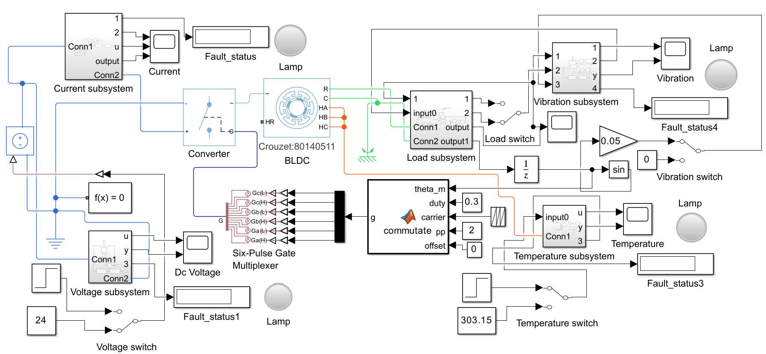
Simulation Base Model
Notes:
MATLAB/Simulink model: DC source, converter, BLDC motor, commutation logic, load and four fault-monitoring subsystems (current, voltage, vibration, temperature) with lamps and status displays.

Slide 10
Simulation Circuit Diagram
+24 V
A
Motor thermal ports and rotor speed feed the temperature and vibration subsystems.
Gate drive: Ga, Gb, Gc (H / L)
Ga(H)
+ diode
Gb(H)
+ diode
Gc(H)
+ diode
24 V
DC
BLDC
Motor
Load
(J, T)
V
A
B
C
Ga(L)
+ diode
Gb(L)
+ diode
Gc(L)
+ diode
0 V
A Current sensor
V Voltage sensor
Commutation logic (MATLAB function)
fixed duty 0.3 · carrier · 2 pole pairs · no speed loop
Hall HA, HB, HC (rotor position)
Notes:
Power circuit of the Simulink model: 24 V DC source, current and voltage sensors, a three-phase six-switch converter driven by the commutation logic with fixed duty 0.3, and the BLDC motor with its load. There is no speed controller.

Slide 11



Commutation & Power Stage
Sector table
Commutation Logic
Uses rotor position feedback to generate the gate-switching sequence for electronic commutation.
Sector | High side (PWM) | Low side (on) | Floating
0 | A | B | C
1 | A | C | B
2 | B | C | A
3 | B | A | C
4 | C | A | B
5 | C | B | A
Three-Phase Power Converter
Switches chop the 24 V DC input into regulated three-phase PWM voltages for the motor phases.
BLDC Motor Block
Simscape model that converts electrical energy into mechanical rotation and torque.
Notes:
Commutation uses rotor position to pick which phases are driven; the converter chops the 24 V supply into three-phase PWM voltages.

Slide 12
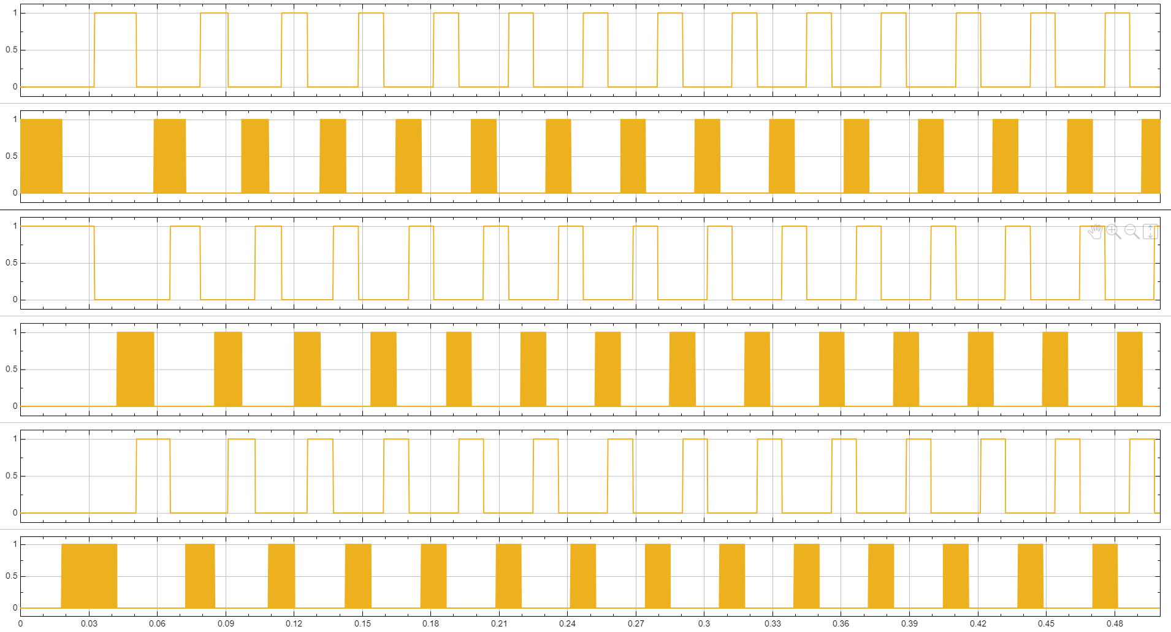
Gating Signals
High side
Switched with PWM chopping
Low side
Held ON during its sector
Sector
Chosen from rotor position
Notes:
Six gate signals: Ga, Gb and Gc, each with a high-side (H) and a low-side (L) signal.

Slide 13
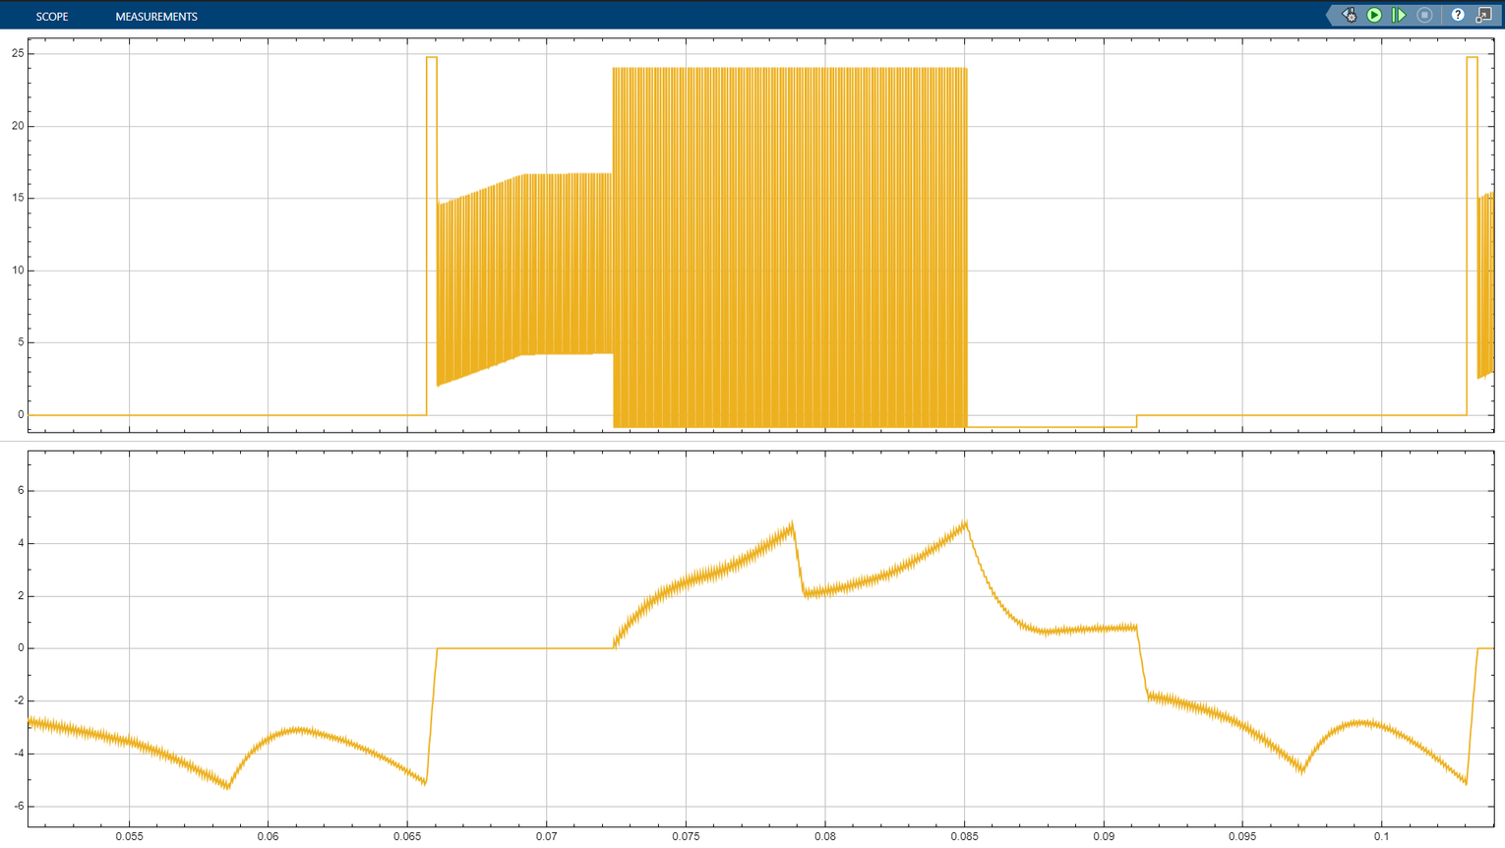
Phase Voltage & Current Waveforms
1
Low side ON
0 V · current negative, growing
2
Low side turns off
Spike to 24 V · current falls to 0
3
Phase open
Voltage follows back-EMF · current 0
4
High side PWM
Dense 24 V pulses · current rises
5
Both OFF
Flat −1 V · current decays slowly
Top: phase A voltage · Bottom: phase A current
6
Low side ON again
Back to 0 V · cycle repeats
Notes:
Phase A voltage (top) and current (bottom) over one electrical cycle, split into six stages.

Slide 14
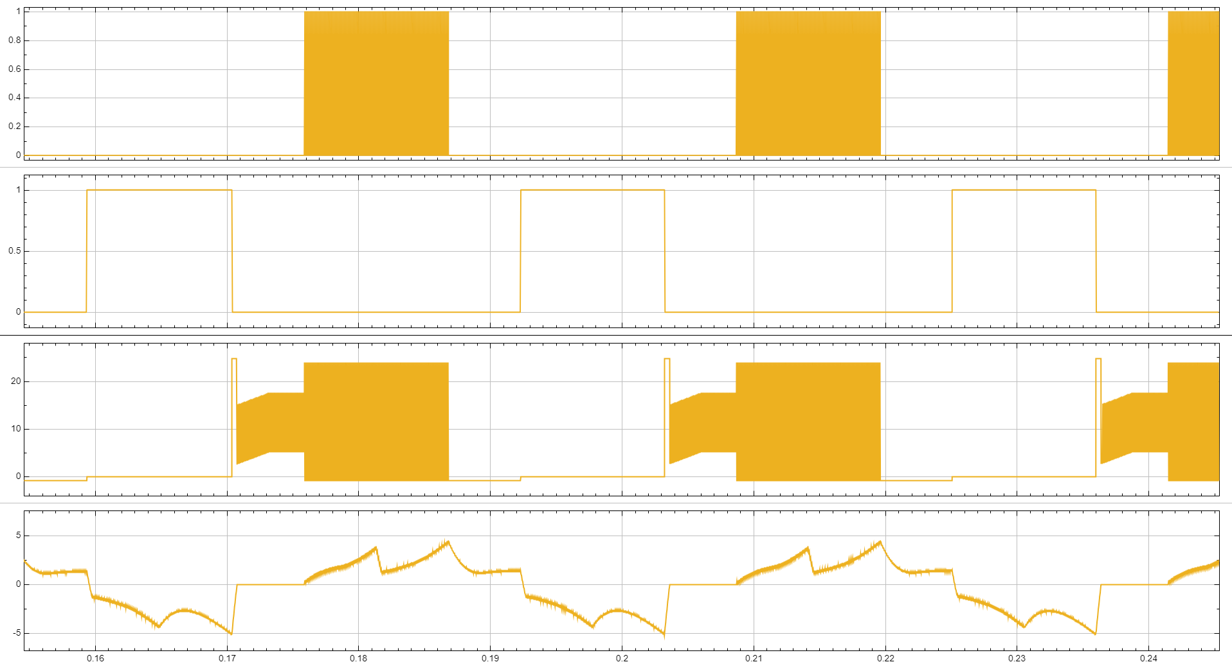
Phase A: Gating vs Response
Ga(H) bursts
PWM bursts produce the voltage pulses
Ga(L) pulses
0 V and negative current while the low side conducts
Every cycle
Current repeats with the commutation pattern
Notes:
Ga(H) and Ga(L) gate signals with the resulting phase A voltage and current.

Slide 15
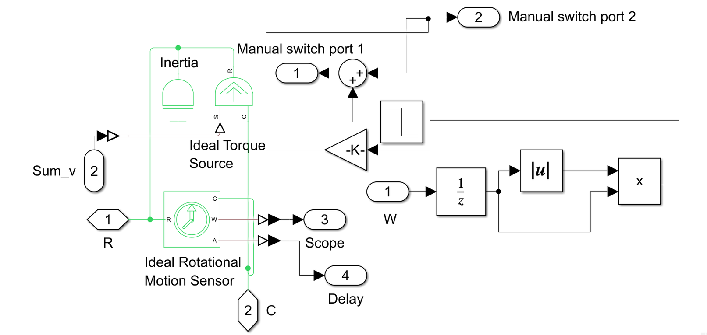
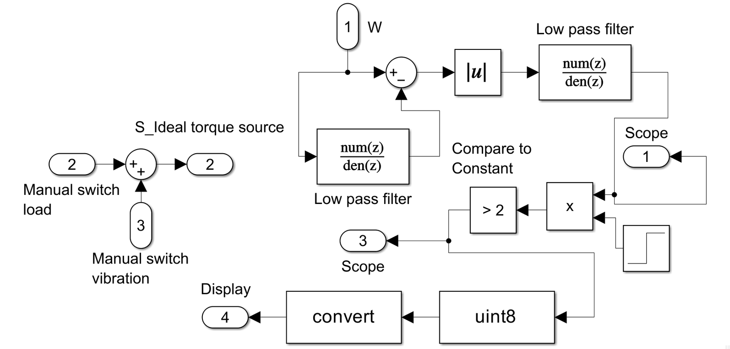
Load & Vibration Subsystems
Load subsystem
Vibration subsystem
Generates the mechanical resistance the motor works against. It takes rotor speed, adds drag and step loads in a Sum block, and drives the Ideal Torque Source to brake the shaft.
Rotor position goes through a sine block and gain 0.05 into the load Sum block to inject ripple. Detection: filtered speed difference, low-pass filter, compare > 2.
Notes:
Load subsystem creates the opposing torque; the vibration subsystem injects ripple and detects it.

Slide 16
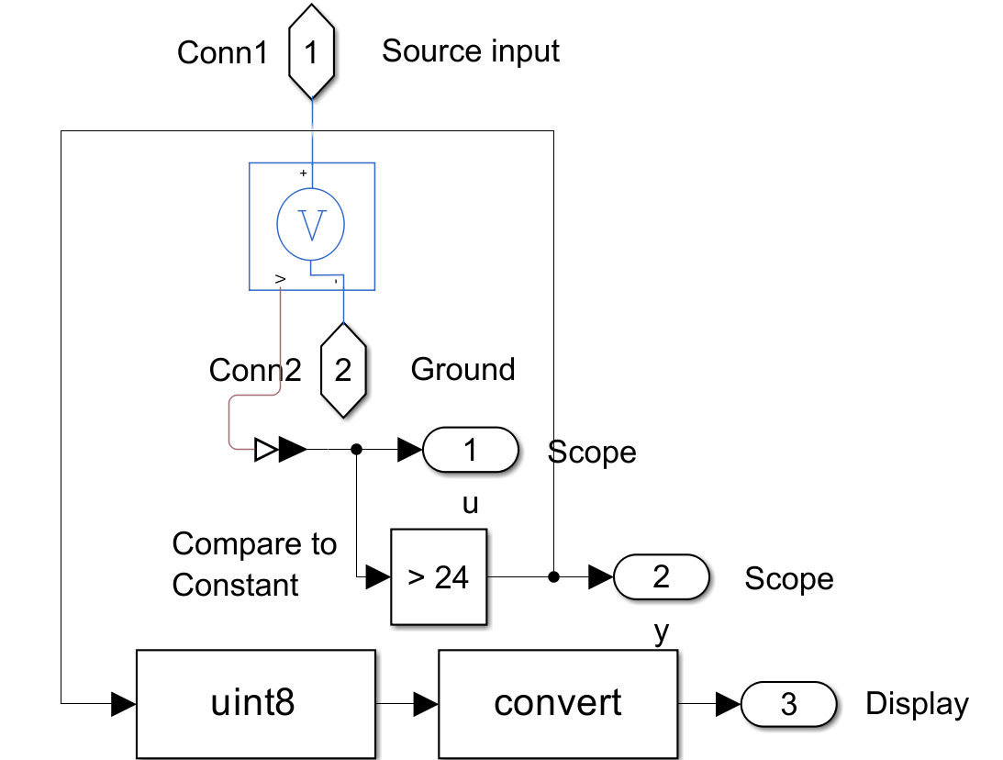
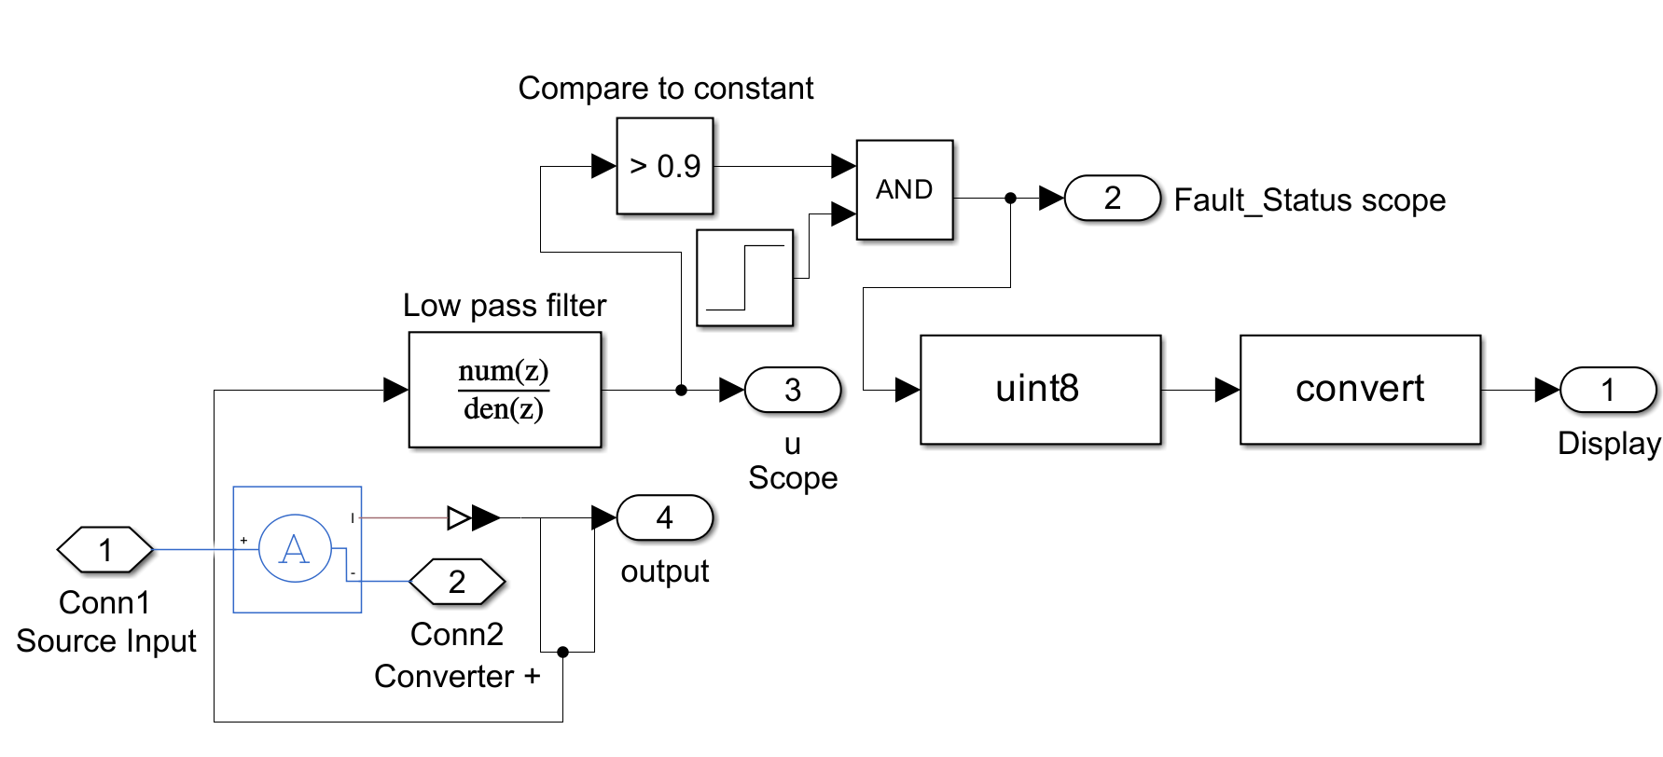
Current & Voltage Subsystems
Current subsystem
Voltage subsystem
Phase current is low-pass filtered to strip PWM noise, compared with 0.9 A and gated by a step enable to raise the fault flag.
A voltage sensor across the DC link feeds a compare-to-constant (> 24) block that sets the over-voltage flag.
Notes:
Current is filtered and compared with 0.9 A; DC-link voltage is compared with 24 V.

Slide 17
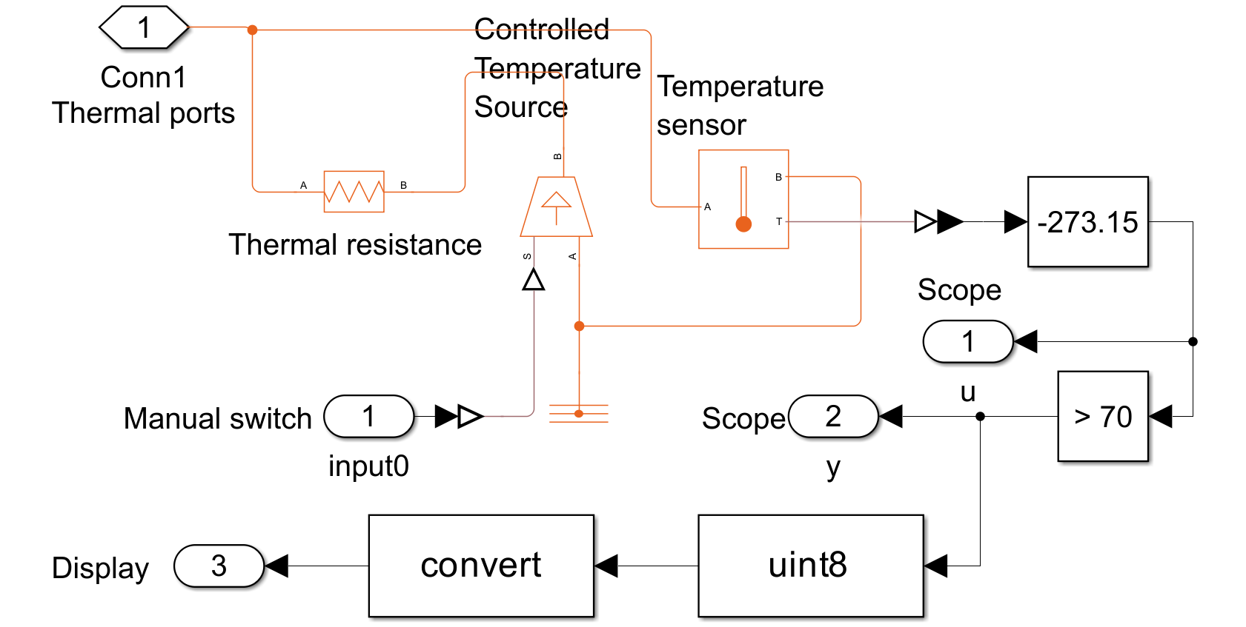
Temperature Subsystem
Thermal path
BLDC thermal ports (HA, HB, HC, HR) connect through a 2 K/W thermal resistance to a 30 °C ambient source.
Detection
Sensor output in kelvin minus 273.15 gives °C; a compare block flags a fault above 70 °C.
Notes:
Thermal ports of the BLDC model connect through a 2 K/W thermal resistance to a 30 degC ambient source; the sensed temperature is compared with 70 degC.

Slide 18
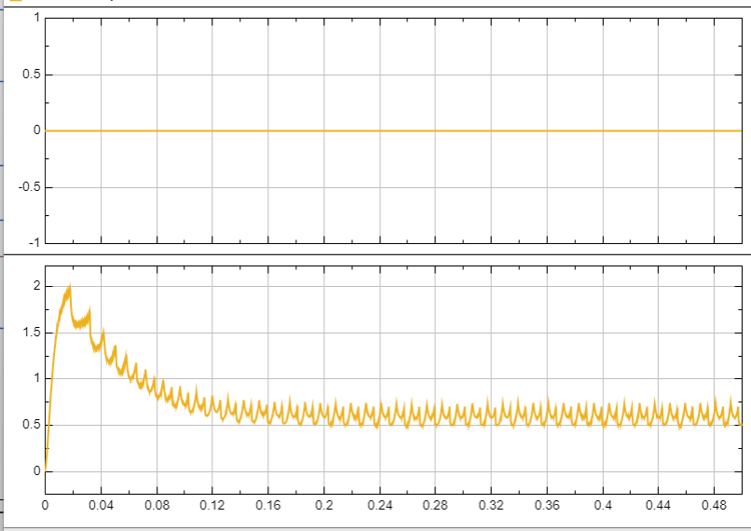
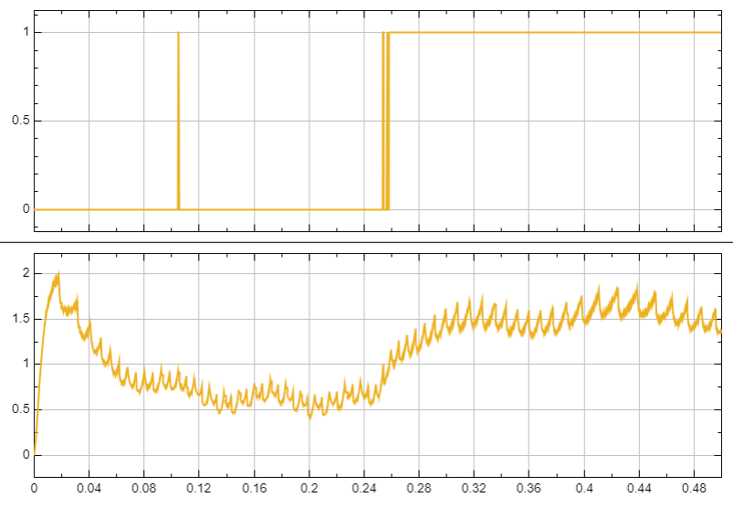
Current Output
Condition: A fault is triggered whenever the motor current exceeds 0.9 A.
NORMAL
Top: fault flag · Bottom: current
FAULT
Top: fault flag · Bottom: current
Steady state: the motor draws 0.5068 A against a load torque of −0.01841 N·m.
Current surges to 1.357 A against an opposing torque of −0.1554 N·m; the flag goes high.
Notes:
Normal vs fault current waveforms with the fault indicator.

Slide 19
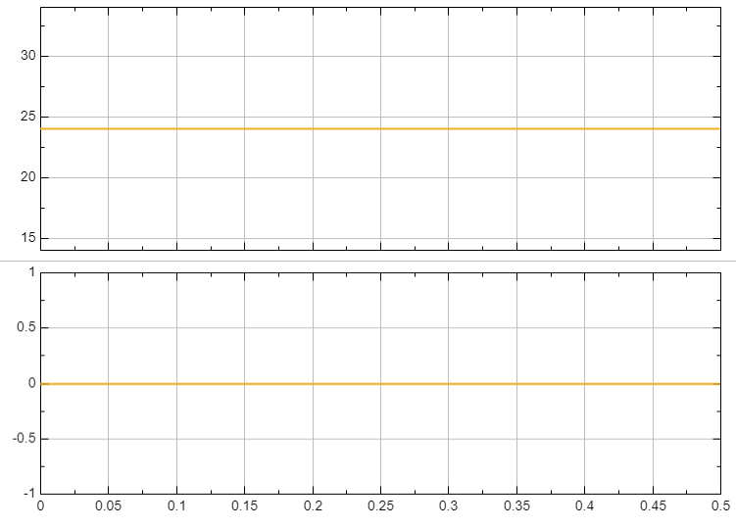
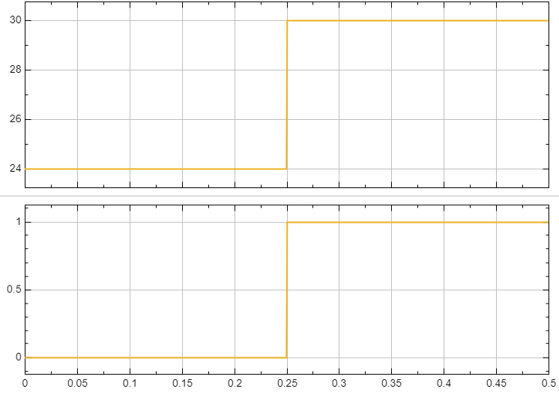
Voltage Output
Condition: An over-voltage is detected whenever the supply voltage rises above 24 V.
NORMAL
Top: supply voltage · Bottom: fault flag
FAULT
Top: supply voltage · Bottom: fault flag
Stable input and output voltage of 24 V; no fault.
Supply raised to the fault level of 30 V; the over-voltage flag is set.
Notes:
Supply voltage and fault flag for normal and over-voltage cases.

Slide 20
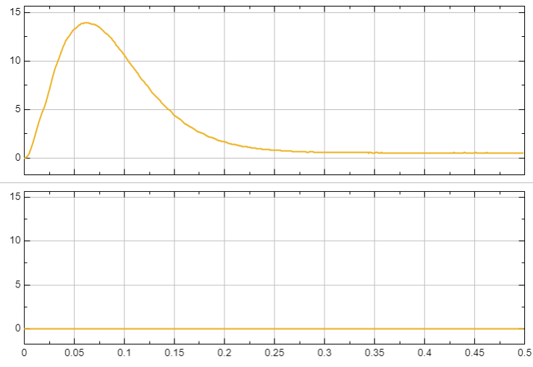
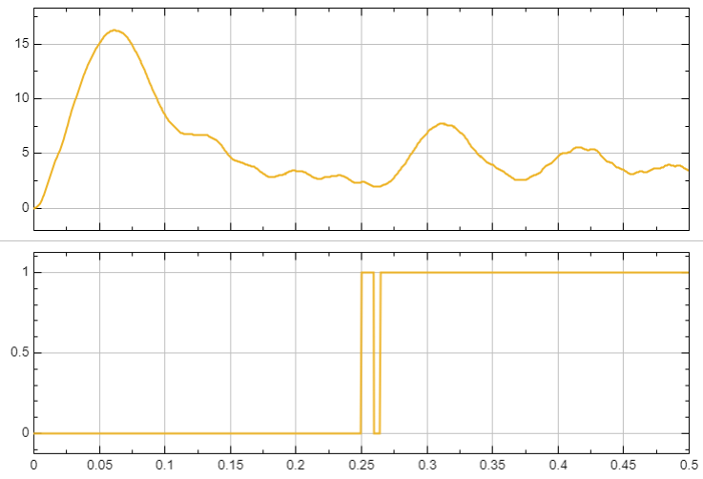
Vibration Output
Condition: A high-vibration fault is registered whenever the output exceeds 2.
NORMAL
Top: vibration · Bottom: fault flag
FAULT
Top: vibration · Bottom: fault flag
Vibration level of 0.5147 with zero torque ripple.
With the ripple circuit active the output reaches 3.459 (torque ripple 0.002688); the flag is set.
Notes:
Vibration level and fault flag.

Slide 21
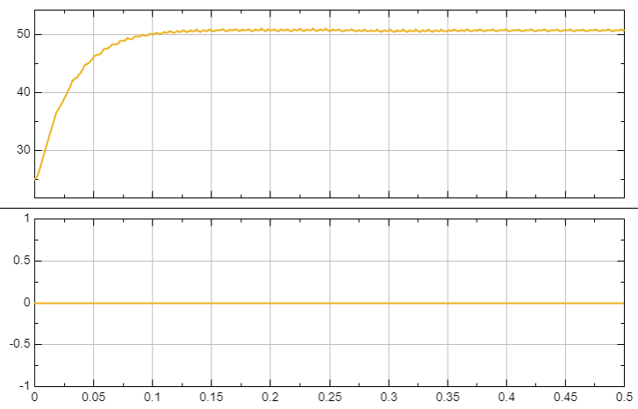
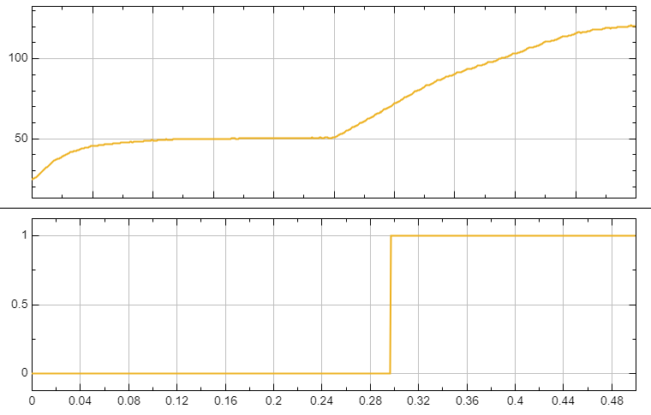
Temperature Output
Condition: A thermal fault is activated whenever the internal temperature exceeds 70 °C.
NORMAL
Top: temperature · Bottom: fault flag
FAULT
Top: temperature · Bottom: fault flag
Motor temperature settles at 50.72 °C against a 30 °C (303.1 K) ambient.
Trapped heat drives the temperature to 120.1 °C, above the limit; the fault flag is set.
Notes:
Temperature rise and the fault indicator.

Slide 22
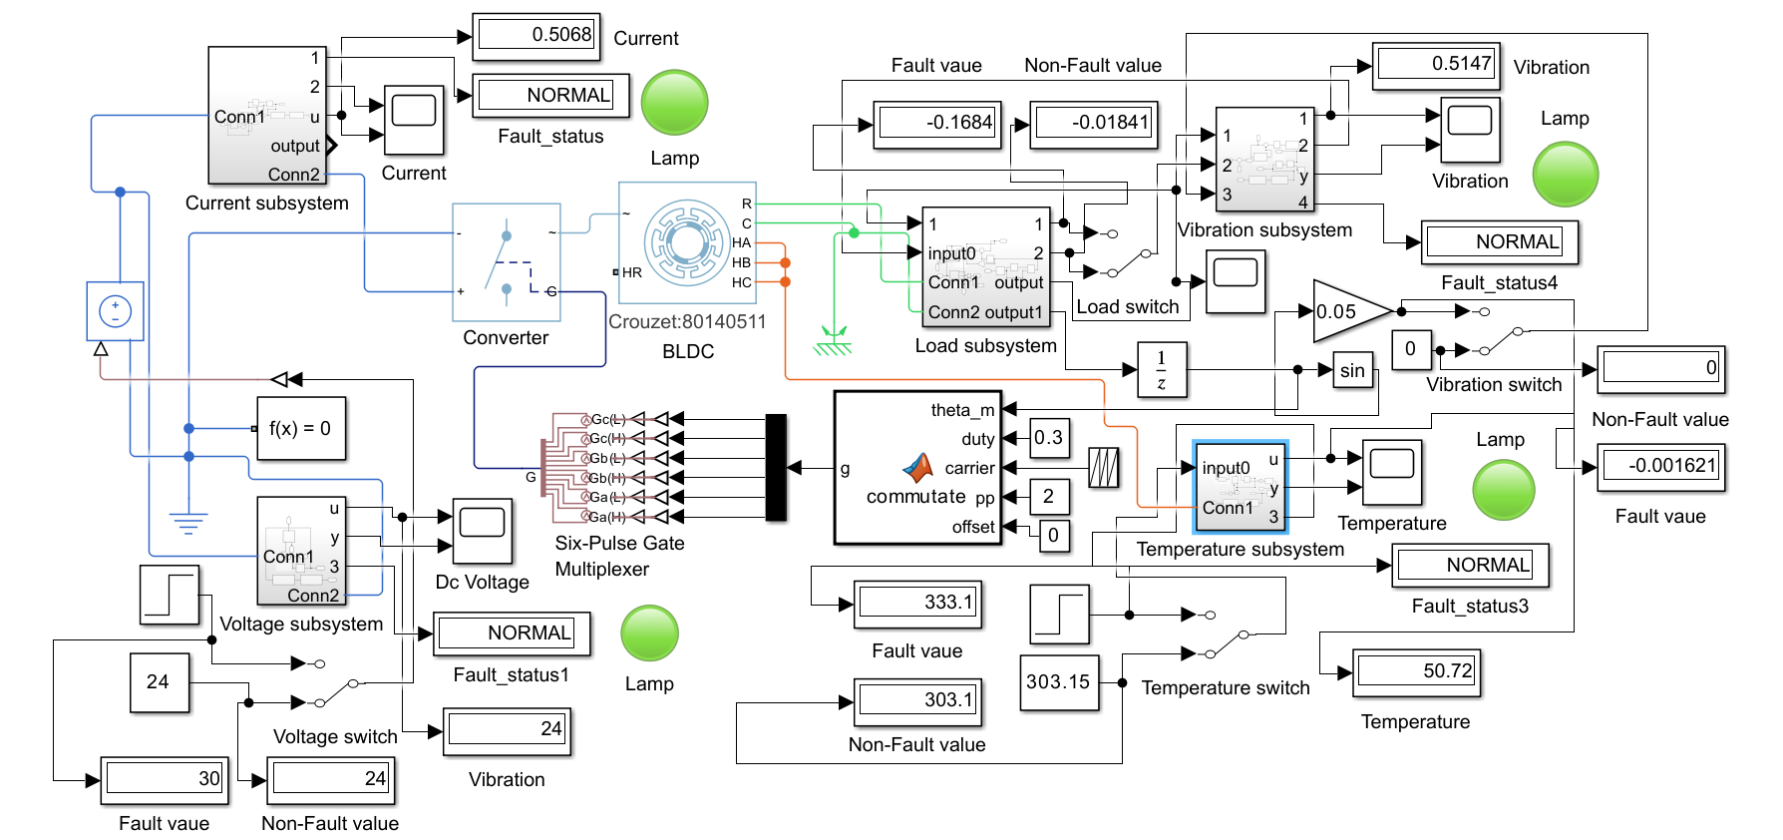
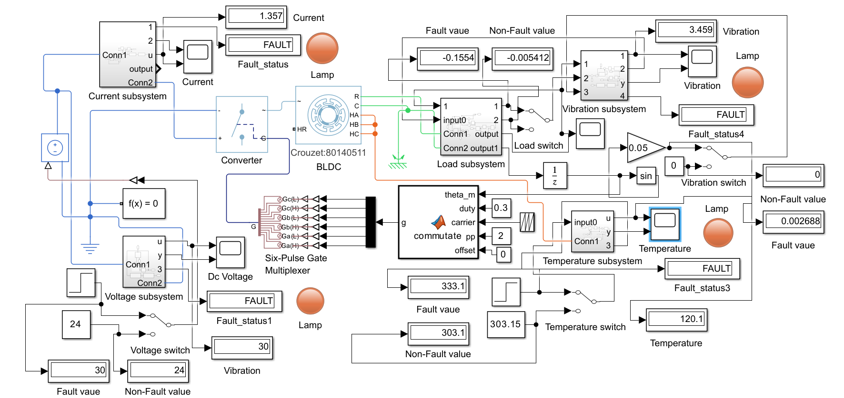
Simulation Output: Normal vs Fault
NORMAL
FAULT
Parameter | Normal | Fault | Fault condition
Current | 0.5068 A | 1.357 A | > 0.9 A
Voltage | 24 V | 30 V | > 24 V
Vibration | 0.5147 | 3.459 | > 2
Temperature | 50.72 °C | 120.1 °C | > 70 °C
Notes:
Lamps turn from green to red and status displays change from NORMAL to FAULT when each parameter crosses its limit.

Slide 23
Simulation vs Hardware
Parameter | Simulation (MATLAB/Simulink) | Hardware (ESP32 prototype)
Supply | 24 V DC source | 24 V SMPS
Current | Fault > 0.9 A | ACS712-30A on GPIO34 · F01 > 8 A
Voltage | Fault > 24 V (30 V injected) | Divider sensor on GPIO35 · F02 < 20 V, F03 > 28 V
Temperature | Fault > 70 °C (thermal model) | DS18B20 on GPIO4 · F04 > 60 °C
Vibration | Fault > 2 (filtered ripple) | MPU6050 · F05 axis > 15 / 15 / 20 m/s²
Status output | Lamps and displays | OLED (12 pages) and Blynk (50 virtual pins)
Thresholds are set separately for the simulated motor and the hardware prototype.
Notes:
The simulated monitoring logic is carried over to the ESP32 prototype with thresholds set for the hardware sensors.

Slide 24
System Architecture
Interface
OLED Display
12 pages
Wi-Fi
Blynk Cloud
Mobile / Web
App
Processing
(ESP32)
Acquire
sensors
Power &
Energy
Fault
Detection
Motor
Protection
Health
Analytics
Flash
Logging
Sensing
Voltage Sensor
ACS712 30A
DS18B20
MPU6050
Power & Drive
24V SMPS
BLDC Driver
BLDC Motor
Sensor data flows up to the ESP32; the EN signal flows down to the driver.
Notes:
Four layers: power and drive at the bottom, sensing above it, the ESP32 firmware in the middle, and the OLED plus Blynk cloud interface on top. Sensor data flows up; EN and PWM control flows down to the driver.

Slide 25
Block Diagram
Power
Sensing
Data
Control
24V SMPS
BLDC Driver
BLDC Motor
DC supply
Motor drive
Machine under test
Voltage Sensor
ACS712
EN
DS18B20
MPU6050
across supply
in series (current)
on motor body
on motor frame
OLED Display
ESP32
Wi-Fi → Blynk
SSD1327 · SPI
Sense · Analyse · Protect
Web / mobile dashboard
Notes:
Power path on top; sensors measure the motor and supply; the ESP32 processes and sends data to the OLED and Blynk.

Slide 26





Hardware & Software Components
ESP32
BLDC Motor
BLDC Driver
Controller + Wi-Fi
Machine under test
Enable (EN) input
ACS712 30A
Voltage Sensor
DS18B20
Current sensing
Divider module, ×7.3
Temperature, 1-Wire
MPU6050
SSD1327 OLED
24V SMPS
Accel + gyro, I2C
128×128 SPI display
DC power supply
Software: Arduino IDE · ESP32 core · Blynk · U8g2 · Adafruit MPU6050 · DallasTemperature + OneWire · Preferences
Notes:
Nine hardware parts and the role of each.

Slide 27
Circuit Diagram: Power & Sensing
OUT → GPIO34 (ADC)
EN ← GPIO25 · PWM (fixed) ← GPIO26
ACS712 30A
+24V
IP+
IP−
VIN
U
U
5V supply
BLDC
Driver
BLDC
Motor
24V
SMPS
V
V
GND
GND
W
W
+24V
Tie ESP32 GND to SMPS GND (common ground).
Voltage Sensor
GND
S → GPIO35 (ADC)
Motor phases
VIN+ / VIN− across supply
Signal
Notes:
24V SMPS feeds the BLDC driver through the ACS712 (current sensed in series). The voltage sensor is connected across the supply. Motor phases U, V, W go to the motor. ESP32 ground is common with the supply ground.

Slide 28
Circuit Diagram: Sensor Connections
ACS712 30A
ESP32 DevKit
3V3
DS18B20
5V
4.7k
VCC
3V3
OUT
GPIO34 (ADC)
GPIO4 (1-Wire)
DATA
GND
GND
GND
24V
Voltage Sensor
MPU6050
S
GPIO35 (ADC)
GPIO21 (SDA)
SDA
VCC
3V3
GND
GPIO22 (SCL)
SCL
GND
GND
ACS712-30A idles at 2.5 V and adds 66 mV per amp, so its output stays below 3.3 V up to about 12 A.
MPU6050: ±8 g, ±500 °/s, 21 Hz filter. Voltage module is scaled so 24 V ≈ 3.3 V (×7.3).
VIN 5V → ACS712 VCC
3V3 → DS18B20 / MPU6050
GND → all grounds
Notes:
ACS712 OUT goes to GPIO34 and the voltage sensor output to GPIO35 (both ADC1). The DS18B20 data line uses GPIO4 with a 4.7k pull-up. The MPU6050 is on I2C: SDA GPIO21, SCL GPIO22.

Slide 29
Circuit Diagram: OLED & Driver Control
BLDC Driver
ESP32 DevKit
SSD1327 OLED
EN
GPIO25 (EN)
GPIO5 (CS)
CS
GND
VCC
3V3
PWM
GPIO26 (PWM)
GPIO27 (DC)
DC
GPIO14 (RST)
RST
GND
GND
GPIO18 (SCK)
SCK
GPIO23 (MOSI)
MOSI
EN = HIGH runs the drive; the ESP32 pulls it LOW on over-current, over-voltage or over-temperature. PWM on GPIO26 is held at 100% duty, so speed is not controlled.
128×128 OLED on 4-wire hardware SPI, 3.3 V.
3V3 → OLED VCC
GND → driver and OLED GND
Notes:
The SSD1327 OLED uses 4-wire hardware SPI: CS GPIO5, DC GPIO27, RST GPIO14, SCK GPIO18, MOSI GPIO23. The driver enable pin is GPIO25 and PWM is GPIO26.

Slide 30
Working Principle & Flowchart
Initialize & Self-Test
Calibrate ACS712
Read Sensors
Power & Energy
1
2
3
4
Repeat (500 ms)
Update OLED & Blynk
Protect & Health Analysis
Detect Faults
8
7
6
5
Calibration runs once at start-up; step 8 returns to step 3. Blynk data is sent every 1 s.
Notes:
Walk through the loop: initialise, read, calculate, detect, analyse, display, upload, repeat.

Slide 31
Sensor Details
Sensor | Pin | Measures | Configuration | Used for
Voltage sensor | GPIO35 | Supply voltage | Divider module, reading × 7.3 | Under / over voltage
ACS712-30A | GPIO34 | Motor current | 66 mV/A, zero offset calibrated at start-up | Over current, stall, no load
DS18B20 | GPIO4 | Temperature | 1-Wire, −55 °C to +125 °C | Over temp, rapid rise, cooling health
MPU6050 | I2C 21 / 22 | Vibration | ±8 g, ±500 °/s, 21 Hz filter | High vibration, shock, bearing health
Calculations: P = V × I · E = E + P·Δt · Vibration = √(ax²+ay²+az²) · Load = I ÷ 10 A × 100 %
Notes:
Each sensor, its ESP32 pin, how it is configured in the code, and which faults it feeds.

Slide 32
Fault Detection
F01
Over Current
> 8 A
F09
Sensor Failure
invalid or missing sensor
F02
Under Voltage
< 20 V
F10
Power Overload
> 180 W
F03
Over Voltage
> 28 V
F11
Current Fluctuation
step > 2 A
F04
Over Temperature
> 60 °C
F12
Rapid Temp Rise
> 5 °C in 30 s
F05
High Vibration
axis > 15 / 15 / 20 m/s²
F13
Shock
axis > 25 / 25 / 30 m/s²
F07
No Load
< 0.2 A for 5 s
F14
High Energy
> 1000 Wh
F08
Motor Stall
> 6 A, low motion
F15
Blynk Offline
cloud disconnected
Notes:
Fourteen fault codes. They are checked in priority order and the first match is reported as the motor status.

Slide 33



Motor Protection & Control
Fault flags
ESP32 logic
Enable pin
Motor stops
Over current, over voltage or over temperature.
Checked on every loop cycle, about 500 ms.
GPIO25 is driven LOW to disable the driver.
Drive stays off until the fault clears.
Automatic restart
Fixed drive level
EN returns HIGH as soon as all three fault flags clear.
GPIO26 outputs 10 kHz PWM held at 100 % duty; the motor speed is not controlled.
Notes:
When over-current, over-voltage or over-temperature is detected, GPIO25 (EN) goes LOW and the driver is disabled. It re-enables automatically when the faults clear.

Slide 34
Predictive Maintenance
Health Score
100 − penalties
Below 60 → service required
≥ 90
EXCELLENT
≥ 75
GOOD
≥ 60
WARNING
≥ 40
SERVICE
< 40
CRITICAL
Bearing
Cooling
Electrical
MOTOR HEALTH
Average of the three, giving remaining life and wear %
Vibration above 18 and 25 m/s²
Temperature above 45, 55 and 65 °C
Current above 5 / 7 A, voltage below 22 V or above 26 V
Output: CHECK BEARING · CHECK COOLING · CHECK POWER · GENERAL SERVICE · NORMAL
Notes:
Health score from temperature, current, voltage and vibration; sub-health values for bearing, cooling and electrical; the average gives motor health, remaining life and wear.

Slide 35


Performance & Diagnostics
Statistics
Performance analysis
Maximum and average of voltage, current, temperature, power and vibration.
Estimated efficiency and power factor, load %, performance and reliability index.
Self-diagnostics
Data logging
Six checks: voltage, current, temperature, MPU6050, Wi-Fi and Blynk.
Energy, run time and fault count saved every 30 s; last 10 faults kept with time.
Notes:
Beyond fault detection the firmware tracks statistics, estimates performance, self-checks six items and stores key data in flash.

Slide 36
OLED Output (12 Pages)
1
Institution
2
Drive System
3
Temperature
4
Vibration
Title page
V · I · P · E
Value and state
AX · AY · AZ
5
System
6
Fault Status
7
Motor Health
8
Fault History
Motor, I, V, vibration
Code · event · count
Score · run time
Last 5 faults
9
Statistics
10
Predictive
11
System Status
12
Performance
Max / average values
Bearing · cooling · life
Sensors, Wi-Fi, Blynk
Eff · load · PF
Pages rotate automatically every 3 seconds on the SSD1327 display.
Notes:
The 128×128 OLED rotates through twelve pages, changing every three seconds.

Slide 37
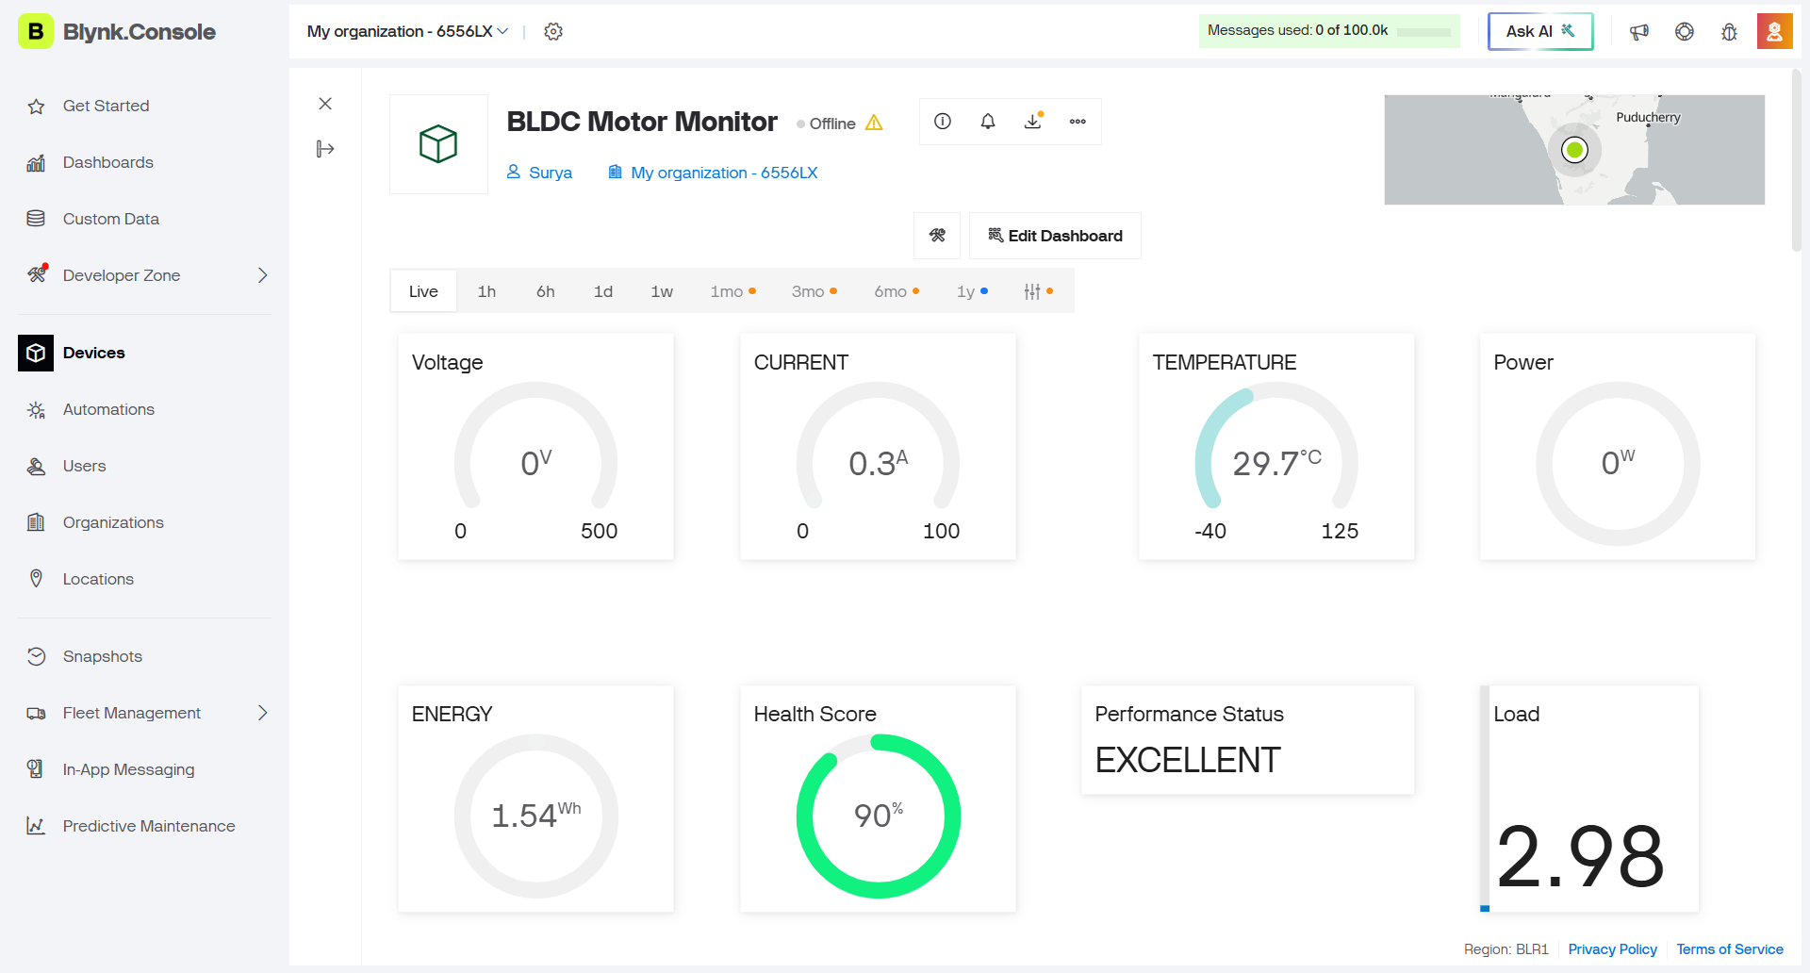
Blynk Dashboard
Datastream groups
Live data
V0–V4, V9
Fault & status
V5–V8, V16–V18
Vibration
V10–V15
Statistics
V19–V26
Predictive health
V27–V33
Diagnostics
V34–V41
Blynk Console: BLDC Motor Monitor dashboard with gauges for voltage, current, temperature, power, energy, health score, performance status and load.
Performance
V42–V49
Notes:
Insert your dashboard screenshot. The right side lists the data stream groups sent every second (V0–V49).

Slide 38
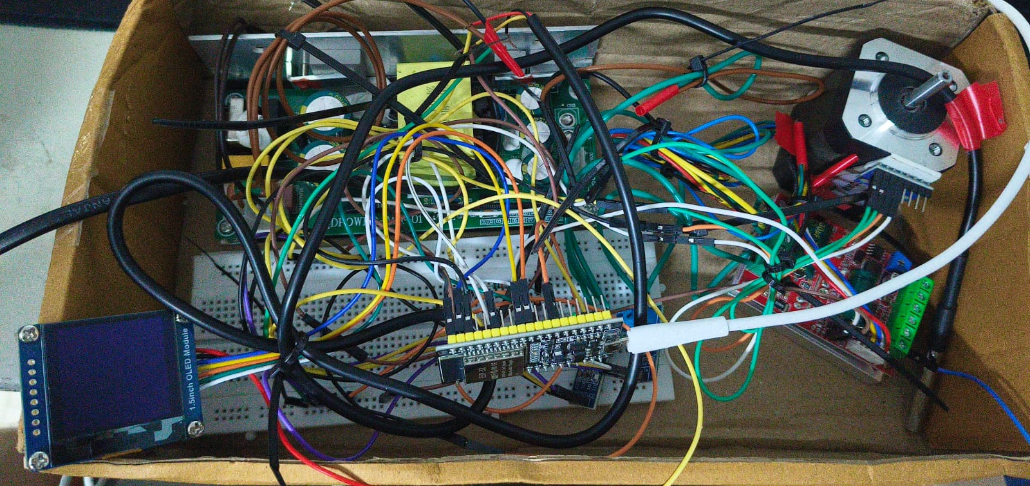

Experimental Setup
IN THE PHOTO
ESP32 and sensors
BLDC driver and motor
24 V SMPS
1.5-inch OLED
Prototype: ESP32 with ACS712, voltage sensor, DS18B20 and MPU6050, powered from a 24 V SMPS through a BLDC driver.
Notes:
Photo of the working prototype: ESP32 on a breadboard, 24 V SMPS, BLDC driver and motor, and the 1.5-inch OLED module.

Slide 39
Expected Outcomes
Intelligent, self-monitoring BLDC motor drive implemented
Predictive maintenance alerts to reduce unexpected breakdowns
Automatic protection on over-current, over-voltage and over-temperature
IoT remote monitoring through an ESP32 dashboard
Real-time monitoring of current, voltage, temperature and vibration
Validation through MATLAB/Simulink and a hardware prototype
Energy consumption analysis and efficiency monitoring
Improved reliability, less downtime and lower maintenance cost
Early fault detection using multi-parameter condition monitoring
Low-cost smart motor drive for industrial automation
Notes:
Ten outcomes the project set out to achieve.

Slide 40


Future Scope
AI fault prediction
SCADA integration
Cloud analytics
RPM / Torque sensing
Learn from fault history to forecast failures.
Connect to plant-level supervisory systems.
Long-term trends and multi-motor analysis.
Add speed and torque for deeper diagnosis.
Notes:
Four directions to extend the project.

Slide 41



Conclusion
A low-cost ESP32-based intelligent BLDC drive that monitors voltage, current, temperature and vibration, detects faults, protects the motor and predicts maintenance, validated through MATLAB/Simulink simulation and a hardware prototype.
Real-time monitoring
Fault detection
Predictive maintenance
Notes:
Summarise what was achieved.

Slide 42
References
Raja, H. A., Raval, H., Vaimann, T., Kallaste, A., Rassolkin, A., & Belahcen, A. (2022). Cost-efficient real-time condition monitoring and fault diagnostics system for BLDC motor using IoT and machine learning.
Wan Mohd Supian, W. R., Mohd Nordin, I. N. A., Khamis, N., & Muhammad Razif, M. R. (2022). Electrical machine breakdown monitoring system using IoT. Journal of Advanced Industrial Technology and Application, 3(2), 1–7.
1
5
IoT based condition monitoring and control of induction motor using Raspberry Pi (2022).
ESP32, Arduino and Blynk IoT documentation.
2
6
do Nascimento, L. S., da Silva, E. P., & Pereira, E. G. (2024). Development of a data acquisition and monitoring system for electric motors using the Internet of Things. CBA 2024. doi:10.20906/CBA2024/4526
Datasheets: ACS712, DS18B20, MPU6050 and SSD1327.
3
7
Arman Sabri, A. S., & Aziz, R. (2025). Motor vibration and temperature detector by using IoT. Evolution in Electrical and Electronic Engineering, 6(2), 347–355.
4
Notes:
Full citations for the reviewed papers.

Slide 43
Thank You

